Slide 1
HEMODYNAMICS- CARDIAC OUTPUT AND SHUNT CALCULATION
DR AJAY NAIR
SENIOR RESIDENT IN CARDIOLOGY
CALICUT MEDICAL COLLEGE

Slide 2
CARDIAC OUTPUT MEASUREMENT

Slide 3
Introduction
Quantity of blood delivered to the systemic circulation per unit time expressed in L/min
Techniques of measurement:
Fick-Oxygen Method
Indicator-Dilution Methods
Indocyanine Green
Thermodilution

Slide 4
Extraction reserve and CO
The extraction of a particular nutrient is expressed as A-V difference across that tissue.
Normal arterial blood saturation: 95%
Normal venous blood saturation: 75%
Extraction Reserve: The factor by which the arterio venous difference can increase at constant cardiac output, owing to changes in metabolic demand.
Normal extraction reserve for O₂ : 3.
Under extreme metabolic demand, tissues can extract upto 120ml of O₂(40×3) from each liter of blood delivered.

Slide 5
As the cardiac output falls, extraction of O₂ by the tissues increases.
Upto 1/3 fall in C.O can be compensated by 3 times increase in extraction reserve.
C.O below one third of normal- incompatible with life (CI ≤ 1.0 L/min/m²).
Upper limit of C.O in trained athletes- 600% of resting output.
Under extreme exercise, total body O₂ requirement increases to 18 times, which is met by 6 fold rise in C.O and 3 fold rise in extraction reserve

Slide 7
Fick’s Oxygen Method
Proceedings of the Würzburg Physikalische
Medizinische Gesellschaft for July 9, 1870
Adolf Fick
“It is astonishing that no one has arrived at the following obvious method by which the amount of blood ejected by the ventricle of the heart with each systole may be determined directly …”

Slide 8
Adolph fick-1870 and first used by O’ Klein in Prague
Principle
The total uptake or release of any substance by an organ is the product of blood flow to the organ and the arterio venous concentration difference of the substance.
If no intra cardiac shunt PBF=SBF
Q = OXYGEN CONSUMPTION
Arterio venous O₂ Difference
In the absence of a shunt, systemic blood flow (Qs) is estimated by pulmonary blood flow (Qp).

Slide 9
Oxygen consumption
Greatest source of variability.
Uptake of oxygen from room air by the lungs is measured.
Douglas bag method
Polarographic method

Slide 10
Methods of oxygen consumption measurement
Douglas Bag Method

Slide 11
MRM –Water’s Instruments

Slide 12
Douglas Bag Method
Polarographic method
Older
A timed sample of patients expired air is collected in a Douglas bag & analyzed for O₂ content and ( Beckman oxygen analyzer) and volume
O₂ content of room air is also measured
Oxygen consumption per l per minute is calculated
Metabolic rate meter by Waters instruments
Parts: oxygen hood /mask
Polaro graphic oxygen sensor cell
VO₂=O₂ content in the room air – O2 content in the air flowing past the polaro graphic cell
Respiratory quotient is assumed

Slide 13
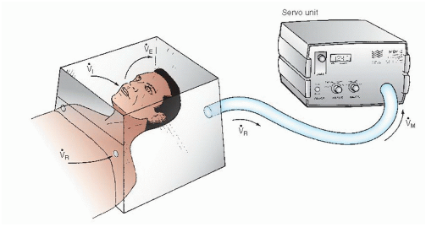
Polarographic O₂ Method
Polarographic O₂ Method
Metabolic rate meter
Device contains a polarographic oxygen sensor cell, a hood and a blower of variable speed connected to the oxygen sensor.
The MRM adjusts the variable-speed blower to maintain a unidirectional flow of air from the room through the hood and via a connecting hose to the polaro graphic oxygen-sensing cell.

Slide 14
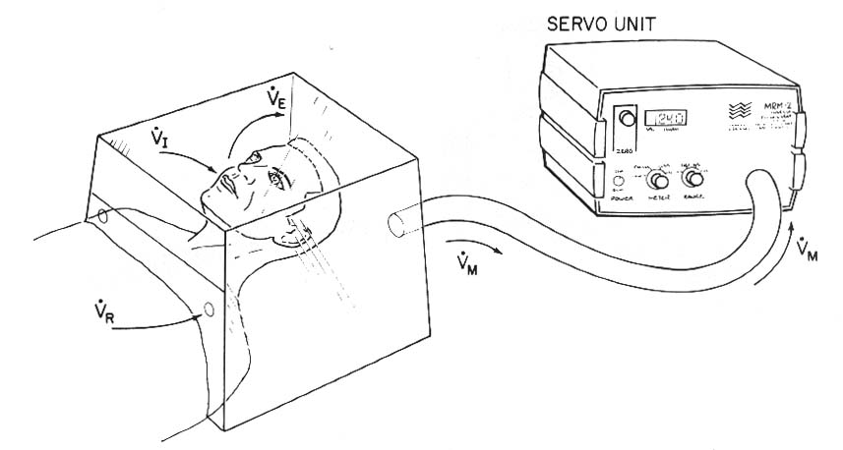
Polarographic O₂ Method
V_{M} = V_{R} - V_{i} + V_{E}
V_{M} = Blower Discharge Rate
V_{R} = Room Air Entry Rate
V_{I} = Patient Inhalation Rate
V_{E} = Patient Exhalation Rate
F_{R}O₂= Fractional room air O2 content = 0.209
F_{M}O₂ = Fractional content of O2 flowing past polarographic cell
V_{O2} = (F_{R}O₂ x V_{R}) - (F_{M}O₂ x V_{M})
F_{M}O₂ x V_{M}
V_{O2} = F_{R}O₂ (V_{M} + V_{I} - V_{E}) -
V_{O2} = V_{M} (F_{R}O₂ - F_{M}O₂) + F_{R}O₂(V_{I} - V_{E})
V_{O2} = V_{M} (0.209 - F_{M}O₂) + 0.209 (V_{I} - V_{E})
Servocontrolled system adjusts VM to keep fractional O2 content of air moving past polarographic sensor (FMO2) at 0.199
Respiratory quotient
RQ = V_{I} / V_{E} = 1.0
V_{O2} = 0.01 (V_{M}) + 0.209 (V_{I} - V_{E})
V_{O2} = 0.01 (V_{M})

Slide 15
A-V O₂ difference
Sampling technique
Mixed venous sample
Collect from pulmonary artery
Collection from more proximal site may result in error due to streaming and incomplete mixing.
Arterial sample
Ideal source: Pulmonary vein.
Alternative sites: LV, peripheral arteries.
If arterial desaturation (SaO2 < 95%) present, right-to-left shunt must be excluded.
Measurement
Reflectance (spectophotometric analysis ) oximetry

Slide 16
Step 1: Theoretical oxygen carrying capacity
O₂ carrying capacity (mL O₂ / L blood) =
1.36 mL O₂ / gm Hgb x 10 mL/dL x Hgb (gm/dL)
Step 2: Determine arterial oxygen content
Arterial O₂ content = Arterial saturation x O₂ carrying capacity
Step 3: Determine mixed venous oxygen content
Mixed venous O₂ content = MV saturation x O₂ carrying capacity
Step 4: Determine A-V O₂ oxygen difference
AV O₂ difference = Arterial O2 content - Mixed venous O₂ content

Slide 17
Cardiac Output Measurement by Fick Oxygen Method
Total error ≈ 10%
Sources of Error
Incomplete collection of mixed venous blood sample.
Improper collection of mixed venous sample
Respiratory quotient = 1
Volume of CO₂ expired is not equal to O₂.
Error in O₂ consumption ≈ 6%
Error in AV O₂ difference ≈ 5%. Narrow A-V O₂ differences are more subject to error, and therefore Fick method is most accurate in low cardiac output states where AV O₂ difference is high.

Slide 18
Does VO₂ actually need to be measured
Technical difficulties, expense.
Assumption that O₂ consumption can be predicted from BSA.
Resting O₂ consumption- 125 ml/m² or 110 ml/m² for elderly patients.
Cardiac output by indicator dilution technique -108 patients; VO₂= CO (indicator dilution technique)
126±26 ml/mt/m²
O₂ consumption varied widely among adults at the time of cardiac catheterization.
A V oxygen difference

Slide 19
Indicator/Dye Dilution Method
Mere application of Fick’s principle.
2 types-Continuous infusion and single injection method.
Bolus of indicator substance(non toxic) which mixes completely with blood and whose concentration can be measured
Indicator is neither added nor subtracted from blood during passage between injection and sampling sites
Most of sample must pass the sampling site before recirculation occurs
Indicator must go through a portion of circulation where all the blood of the body becomes mixed

Slide 20
Indicator Dilution Method Cont.…
Indocyanine green (volume and concentration fixed) injected as a bolus into right side of circulation (pulmonary artery)
Samples taken from peripheral artery, withdrawing continuously at a fixed rate , to calculate the amount of dye remaining in heart.
Indocyanine green concentration measured by densitometry
STEWART HAMILTON EQUATION

Slide 22
Errors in Indocyanine Green Method
Unstable over time.
Must be introduced rapidly as single bolus
Indicator must mix thoroughly with blood, and should be injected just proximal or into cardiac chamber
Invalid in Low cardiac output states and shunts that lead to early recirculation
Withdrawal rate of arterial sample must be constant

Slide 23
Thermodilution Method
Fegler 1954 (CONSERVATION OF ENERGY)
Cold saline or 5% Dextrose
Balloon-tipped flow-directed catheter
Thermistor at tip
Opening 25 to 30 cm proximal to the tip
Via vein to PA (proximal opening –SVC or RA, thermistor –PA)
5 to 10 mL to proximal port
Change in temperature at the thermistor recorded

Slide 24
Optimal injection rate : 2.5 ml / sec
Repeated 2-3 times. Average calculated

Slide 25
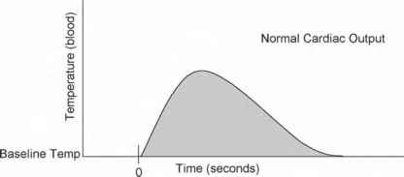

Slide 28
Advantages over indo cyanine green dye method
Withdrawal of blood not necessary
Arterial puncture not required
Indicator (saline or D5W)- inert and inexpensive.
Virtually no recirculation, simplifying computer analysis of primary curve sample

Slide 29
Sources of Error (-15%)
Unreliable in tricuspid regurgitation
Baseline temperature of blood in pulmonary artery may fluctuate with respiratory and cardiac cycles
Loss of indicator with low cardiac output states (CO < 3.5 L/min) due to warming of blood by walls of cardiac chambers and surrounding tissues. The reduction in Δ T_{B} at pulmonary arterial sampling site will result in overestimation of cardiac output
Empirical correction factor (0.825) corrects for catheter warming but will not account for warming of indicator in syringe by the hand

Slide 30
Pitfalls Of CO Measurement
FICK’S METHOD
THERMODILUTION METHOD
Inadequate mixing of blood in RA
Inappropriate sampling
Contamination of blood with air, hep saline.
VO₂-not usually measured.
Improper measurement of VO₂
High output states with narrow A V O₂ difference
Low output states (incomplete mixing of indicator)
AF (incomplete mixing of indicator)
TR (indicator abnormally recirculated)
Intra cardiac shunts (indicator abnormally recirculated)
Administration of IVF simultaneously

Slide 31
Conclusion
In Low cardiac output states, Fick’s method is more reliable.
In high cardiac output states, thermo dilution method is reliable.
In PR, TR and intra cardiac shunts, thermo dilution is not reliable.

Slide 32
SHUNT DETECTION AND QUANTIFICATION

Slide 33
SHUNT :
Detect
Localisation
Quantification
POINTERS TO SUSPECT INTRA CARDIAC SHUNT :
Unexplained Systemic arterial desaturation
PA Saturation Unexpectedly High

Slide 34
INTRODUCTION
O2 CONTENT
Total amount of oxygen present in a blood
(O2 bound to Hb + Plasma Dissolved O2)
Calcuted directly or derived
O2 SATURATION
O2 bound to Hb
O2 CARRYING CAPACITY OF Hb = 1.36 ML O2 PER GRAM OF HB
DISSOLVED O2 = 0.03 x Partial Pressure of O2 in mm Hg
RELATION BETWEEN O2 SATURATION AND CONTENT
O2 content =O2 carrying capacity of Hb x % Saturation +
Dissolved O2

Slide 35
Left to Right shunt:
Oxygenated blood that bypasses the systemic
vascular bed
Right to left shunt:
Deoxygenated blood that bypasses the pulmonary
vascular bed
Admixture lesion:
Anatomical defects facilitates the mixing of
oxygenated & deoxygenated blood
Transposition physiology:
Anatomic abnormality preventing oxygenated blood
reaching the systemic vascular bed

Slide 36
WHEN TO SUSPECT A SHUNT LESIONDURING A CATH STUDY?
1. Unexplained arterial desaturation.
-Arterial SpO2 < 95%
-M.C cause is Alveolar Hypoventilation:-Excess sedation
-COPD
-Pulm. Edema
-Try head up tilt + Deep breaths / Coughing
-Give 100% O2 via rebreathing mask
If full arterial saturation cannot be achieved, a Right to Left shunt is presumed to be present

Slide 37
2. PA blood oxygen saturation > 80% : Suspect a Left to right sterizationhunt.
3.When data obtained at cardiac catheterization does not reveal a clinically suspected structural lesion.
Eg- LV angio failing to reveal an MR in a patient with PSM.

Slide 38
Detection Of Left To Right Shunt
L – RT SHUNT : Detection need “Significant O2 step up” in blood oxygen saturation or content in one of the right heart chamber/PA
Significant Step up : Increase in blood O2 content or saturation that exceeds the normal variability that might be observed if multiple samples were drawn from that cardiac chamber

Slide 39
Screening for Left To Right Shunt
Take blood samples from SVC and PA .
If Δ O 2 saturation between these is ≥8% ,It means Left to right shunt is there .
Go ahead with a complete Oximetry run to locate and quantify the shunt

Slide 40
Catheter for Oximetry run
End hole Catheter (Swan Ganz balloon flotation catheter) or one with side hole near or close to its tip (GL).
Catheter tip position adjusted by pressure measurement
2 ml blood should be taken from each site

Slide 41
OXYMETRY RUN: Sample Collection sites
Left and/or Right PA
MPA
RVOT
Mid RV
RV near TV or Apex
RA (low or near TV).
Mid RA.
High RA
Low SVC (Near junction with RA
High SVC (Near junction with
innominate vein)
IVC high (just at or below
diaphragm)
IVC low (at L4- L5)
LV
Aorta (distal to insertion of ductus)
.

Slide 42
GUIDELINES FOR OPTIMUM USE OF OXIMETRIC METHOD FOR SHUNT DETECTION AND QUANTIFICATION
Blood samples at multiple sites should be obtained rapidly.
The entire procedure should take < 7 Minutes.
Blood O₂ saturation data rather than O₂ content data are preferable
Comparison of the mean of all values obtained in the respective chambers is preferable to comparison of highest values in each chamber.
Because of the important influence of SBF on shunt detection exercise should be used in equivocal cases where a low SBF is present at rest.

Slide 43
GUIDELINES FOR OPTIMUM USE OF OXIMETRIC METHOD FOR SHUNT DETECTION AND QUANTIFICATION conti . .
The sampling to be done with the patient breathing room air or a gas mixture containing no more than a maximum of 30% oxygen
Saturation data may be inaccurate in patients breathing more than 30% oxygen, as a significant amount of oxygen may be present in dissolved form in the pulmonary venous sample.

Slide 44
Normal values for O₂ saturation

Slide 46
Detection of Left to Right Shunt by Oximetry
Criteria for Significant Step up
 | Difference in Mean between Distal and Proximal chamber samples |  | Difference in Highest value between Proximal and Distal chamber |  | Approximate Minimal Q_{p}/Q_{s} required to Detection ( Assuming SBFI=3L/min/M²
 | O₂ % sat | O₂ vol % | O₂ % sat | O₂ vol%
Atrial (SVC/IVC to RA | ≥ 7 | ≥ 1.3 | ≥11 | ≥ 2 | 1.5-1.9
Ventricular (RA to RV) | ≥ 5 | ≥ 1 | ≥ 10 | ≥1.7 | 1.3-1.5
Great vessel (RV to PA) | ≥ 5 | ≥ 1 | ≥ 5 | ≥ 1 | ≥ 1.3
Any level | ≥ 7 | ≥ 1.3 | ≥ 8 | ≥1.5 | ≥ 1.5

Slide 47
Causes of O₂ Step up at various level
Atrial :
ASD
PAPVC
RSOV to RA
VSD with TR
Coronary fistula to RA
Ventricular
VSD
PDA with PR
Ostium Primum ASD
Coronary fistula to RV
Great vessels
PDA
AP window
Abberant coronary artery origin

Slide 48
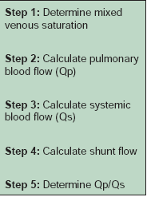
What to do if significant step up detected?

Slide 49
MVO2 Calculation
The mixed venous oxygen content is the average oxygen content of the blood in the chamber proximal to the left to right shunt
FLAMM FORMULA
MVO2 ( At Rest) = 3 SVC O2 + 1 IVC O2
4
MVO2 ( At Exercise) = 1 SVC O2 + 2 IVC O2
3

Slide 50
MVO2 ( Infants) = 3 SVC O2 + 1 IVC O2
4
MVO2 ( Children) = 2 SVC O2 + 1 IVC O2
3

Slide 51
Calculation of Pulmonary Blood flow (Q_{P} )
PULMONARY VEIN SATURATION
If systemic saturation ≥95% - Use the systemic saturation.
If systemic saturation <95%
-Look for Rt to Lt shunt.
-If Shunt present take PVO2 as 98%
-If no shunt use the observed systemic SpO2.

Slide 52
CALCULATION OF SYSTEMIC BLOOD FLOW (Q_{S} )

Slide 53
Magnitude of shunt
Expressed in terms of either Absolute blood flow across
the shunt in L/mt or as a ratio of the PBF to SBF.
Left to right shunt = ( Q_{p}– Q_{S} ) or Q_{P}/Q_{S}

Slide 54
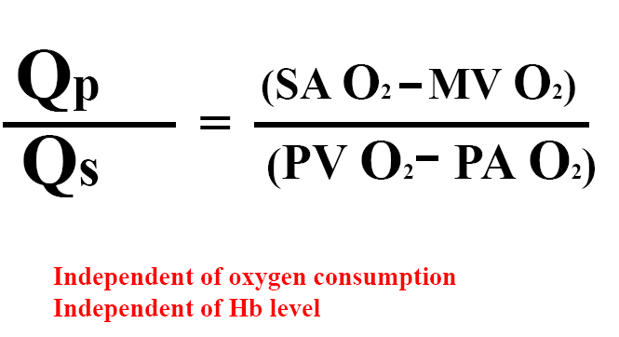
Flow ratio
Use O2 % saturation
Q_{P}/Q_{S} Ratio
< 1 means Right to Left shunt
< 1.5 but >1 means Small left to right shunt
≥2 Large left to Right shunt

Slide 55
Limitation of oximetry method
Absence of steady state during the collection of blood sample
Lacks sensitivity
Elevated SBF will cause mixed venous oxygen saturation to be higher than normal and inter chamber variability will be blunted.

Slide 56
If oxygen content is used for calculating the shunt rather than O2 saturation Hb concentration will effect the result.
Small shunts or in the presence of high cardiac output (which decreases AVO2 difference) oximetry data loses its accuracy
The magnitude of the step-up varies with the oxygen-carrying capacity of blood and the cardiac output.
The relationship between the magnitude of step-up and the shunt flow is nonlinear and with increasing left-to-right shunting, a given change in shunt flow produces less of a change in the saturation step-up.

Slide 57
Other method of shunt detection
Indocyanine green curve
Radionuclide technique
Contrast angiography
Echocardiography

Slide 58
Indocyanine green curve
It can detect shunts too small to be detected by the oxygen step-up method
IF negative , no need to perform a complete oximetry run.

Slide 59
Procedure
Dye injection: Proximal chamber and a sample is taken from a distal
chamber.
Using a densitometer, the density of dye is displayed over time distal chamber
L- RT shunt : Injected to PA sampling done at BA
Finding: Early recirculation on the downslope of the dye
curve
Rt - Lt shunt :
Injected into the right side of the heart proximal to the
location of the suspected shunt and blood samples
obtained from a BA
Findings: Distinct, early peak present on the upslope of the
curve

Slide 60
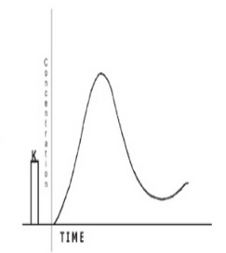
Indocyanine green curve
Normal
LEFT TO RIGHT SHUNT

Slide 61
Right to left shunt

Slide 62
Limitation of Indocyanine green curve
It cannot locate the site of shunt

Slide 63
Angiography
Selective angiography done for visualizing and locating the site of left to right shunt
View
LAO Cranial View: IV Septum, Sinus of Valsalva , AT Aorta , DT Aorta

Slide 64
Detection Of Right To Left Shunt
R-L shunt suspected if cyanosis or arterial desaturation is there (<93%)
If hypoxemia present aim is to find out the location and magnitude of the shunt

Slide 65
Oximetry :
Take Oximetry sampling from PV, LA, LV and Aorta
First chamber which shows desaturation is the site of shunt
Disadvantage: In adults PV & LA entry difficult

Slide 66
Other Methods to detect R to L shunt
Contrast echocardiography
Echo doppler technique

Slide 67
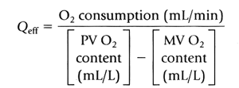
Bidirectional flow
Effective Blood Flow (EBF) is the fraction of mixed venous return received by the lungs without contamination by the shunt flow or the oxygenated blood reaching the systemic circulation without the shunt blood
Left to Right shunt = Q_{P} – Q _{eff}
Right to left shunt = Q_{S} − Q _{eff}

Slide 68
THANK U

